Slide 1
Power Source Options
 | Advantages | Disadvantages
Hydraulic Power Source | -Highest achievable power density | -High maintenance -Heavy -Dirty
Electric Power Source | -Accurate positioning | -Lowest achievable power density -Noncompliant
Pneumatic Power Source | -Higher power density than electric power -Low Maintenance -Compliant action from fluid compression | -Compressible fluid causes inaccuracy in positioning

Slide 2
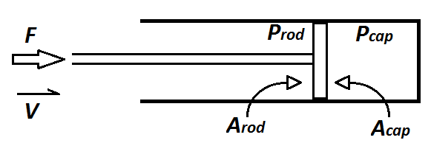

Air Cylinders
Converts fluid power into mechanical power
Position Feedback Sensor
$$F =P_{cap}A_{cap} −P_{rod}A_{rod}$$
Specifications determined by:
-Appropriate bore diameter
-Appropriate necessary pressure
-Appropriate necessary volumetric flow rate

Slide 3

Example Specification
Required force: 178 lbf Stroke length: 4 inch Rod diameter: 0.5 inch
Bore diameter: 2 inches Cycles: 60 per minute
Extend phase: Retract Phase:
$P=\frac{F}{A_{cap}}= \frac{178 {lb}_{f}}{3.1416 {in}^{2}}=56.66 psi$ $P=\frac{F}{A_{cap}−A_{rod}}= \frac{178 {lb}_{f}}{3.1416 {in}^{2} −0.196{ in}^{2}}=56.8 psi$
Total Volumetric Flow:
$Q=A_{piston}D_{Total}NCompression Ratio$
$$Q=\left(3.1416 {in}^{2}\right)\left(8 in\right)\left(60\right)\left(\frac{56.73psi+14.7psi}{14.7psi}\right)$$
$$Q=4.24 \frac{{ft}^{3}}{sec}$$
Resulting Cylinder Specs:
2 inch Bore Diameter
4 inch Stroke Length

Slide 4
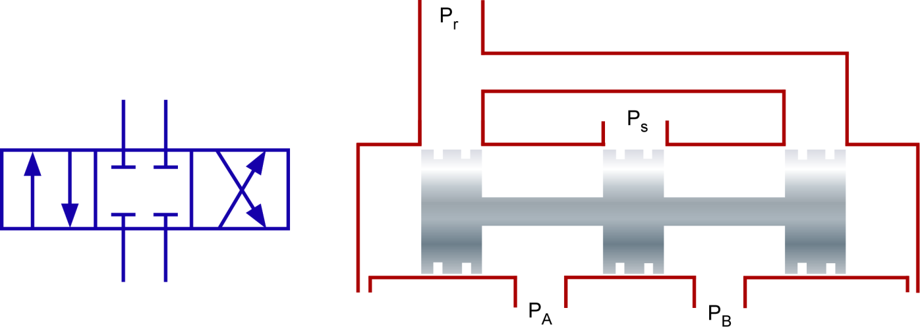

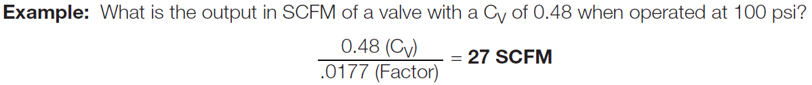
Directional Control Valves
Controls flow through air cylinders based on spool position
4-3 DCV
Specifications determined by:
-Necessary volumetric flow rate to air cylinder

Slide 5
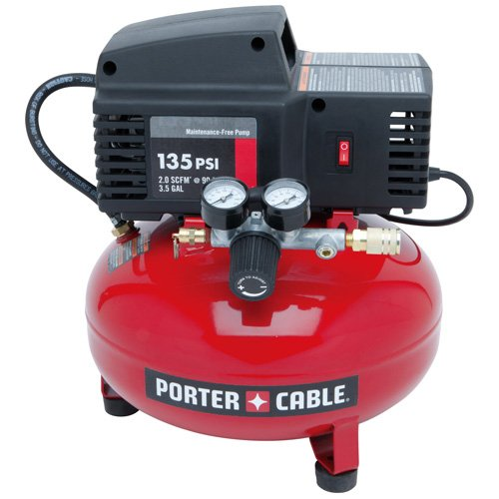
Air Compressor
Compresses air absorbed from
surrounding environment
Feeds to components downstream
Specifications determined by:
-Pressure required by air cylinders
-Volumetric flow rate required by air cylinders

Slide 6
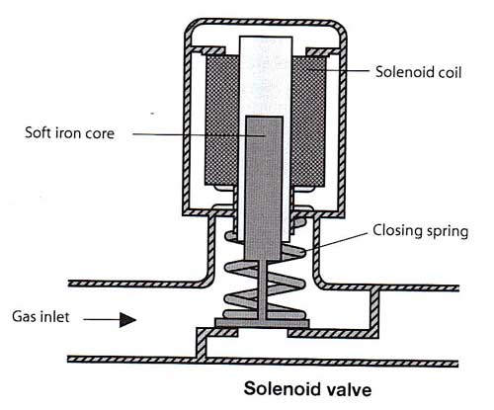
Remaining Pneumatic components include:
Receiver Tank
Solenoid Valve
Pressure Relief Valve
Tubing

Slide 7
Chosen Specifications
Air Cylinders (8):
Directional Control Valves (8):
Air Compressor:

Slide 8
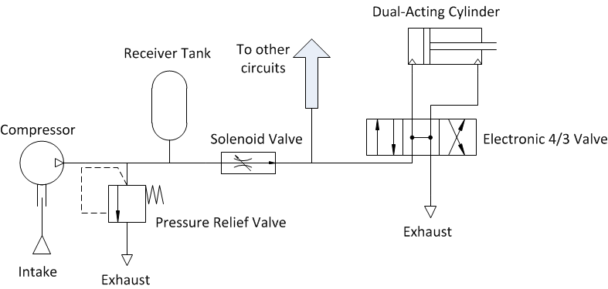
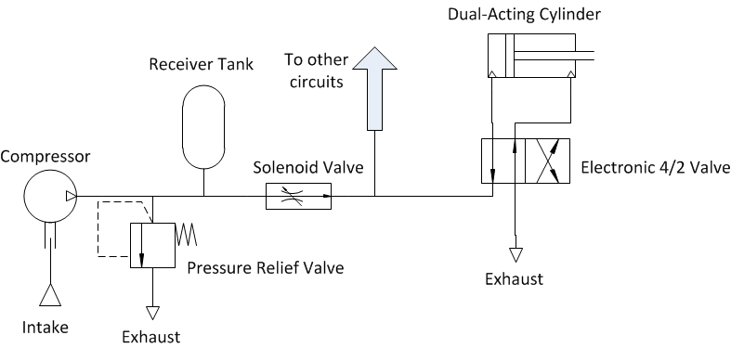
Pneumatic Circuit

